Slide 1


Digital portfolio
Name: Ayisha Fathima Mohamed Ali
NMID:3DC2BC75FF36664A6C24EAC8F5A92010/ autanm41341324213006
Register no:24134130500122006
Department:BCA
College: Deen college of arts and science
Nidur-kaduvangudi

Slide 2
Student digital portfolio

Slide 3

Agenda
Problem statement
Project overview
end users
tools and technologies
portfolio design and layout
features and functionality
results and screenshot
conclusion
github link

Slide 4
Problem statement
Students often struggle to showcase their skills and projects effectively through traditional resumes.A digital portfolio is needed to present technical abilities and achievements in a professional and interactive way.

Slide 5
Project Overview
This is a personal portfolio website created using HTML, CSS, and JavaScript.
It showcases Ayisha Fathima’s skills, projects, hobbies, and contact details in a simple purple-themed design with smooth animations.
---
Project.
Your paragraph text
Studio Shodwe

Slide 6
---
End Users
The main end users of this portfolio are:
Employers & Recruiters – to view skills, projects, and achievements.
Teachers & Mentors – to evaluate academic and project work.
Peers & Collaborators – to connect and work on projects together.
---
Studio Shodwe
Project.

Slide 7
📌 Tools and Technologies
This portfolio is developed using:
HTML – for structure
CSS – for styling and layout
JavaScript – for interactivity and animations
---
id eiusmod ex adipisicing reprehenderit eiusmod veniam velit deserunt nisi eu anim non qui esse mollit et nisi deserunt anim consequat
A

Slide 8
---
📌 Portfolio Design and Layout
The portfolio uses a single-page purple theme with sections for About, Skills, Projects, Hobbies, and Contact, along with a navbar, hero section, and footer for easy navigation.
---
2024
Project.
---
---
Studio Shodwe

Slide 9
---
📌 Features and Functionality
Navigation bar for quick access to sections
Hero section with typing effect animation
About, Skills, Projects, Hobbies, and Contact sections
Interactive hover effects on skills and projects
Contact form for user interaction
Responsive design for different screen sizes
---

Slide 10
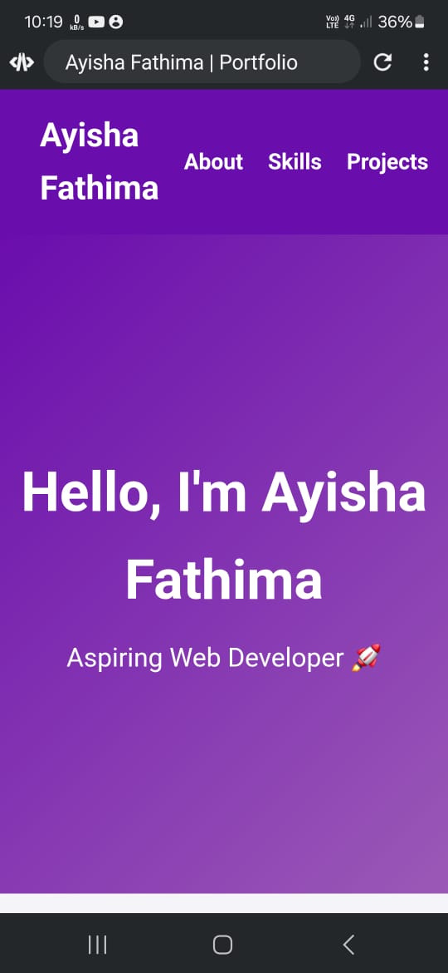
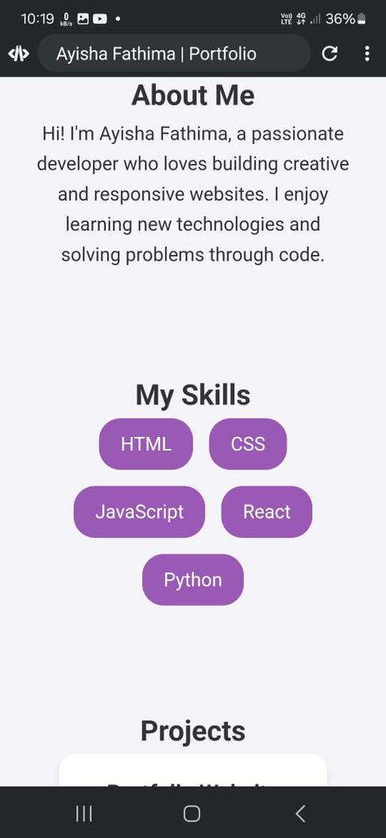
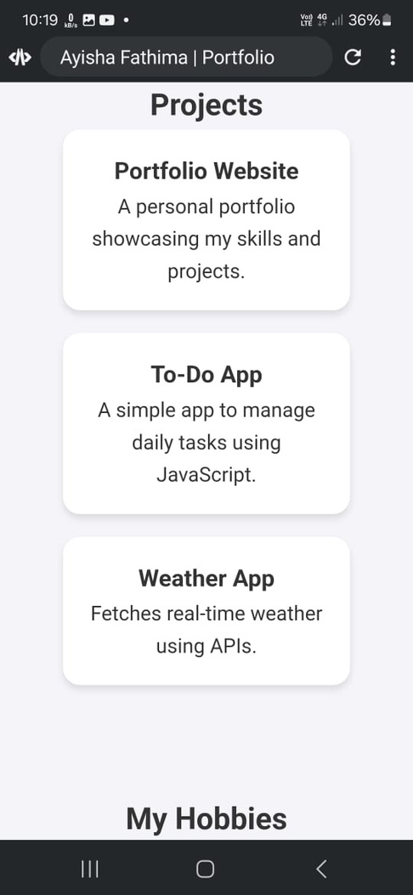
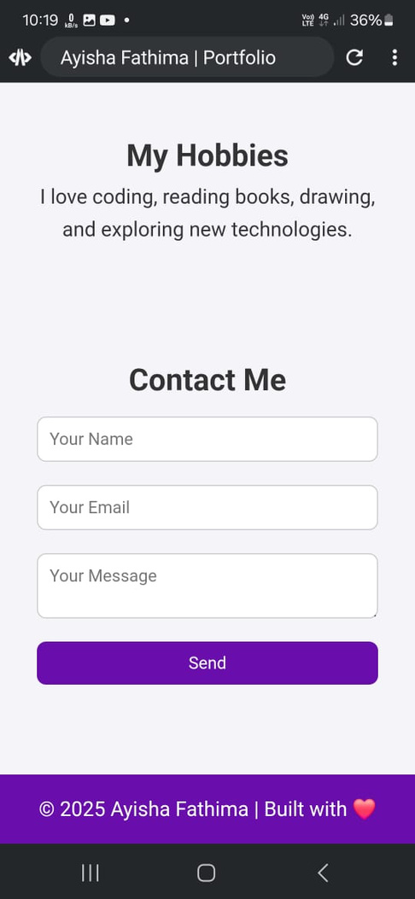
results and screenshot

Slide 11
---
📌 Conclusion
This portfolio website effectively showcases personal skills, projects, hobbies, and contact details in a simple and interactive purple-themed design. It serves as a professional platform for students, recruiters, and collaborators to know more about the developer.
---

Slide 12
https://github.com/dcca24ayisha-byte/Ayisha-Fathima-.git

